Slide 1

Database Design
M2-D5
Participate! The more engagement the better! You are NEVER interrupting me!

Slide 2
Objectives
Database Design Principles
Database Normalization
Class Breakout Session
Break
Database Design Presentations
DDL - Creating Databases - CREATE/DROP - Constraints
Data Definition Language - Building a DB

Slide 3
Database Design
Primary activities:
Data Modeling: the process of clearly and precisely defining the data items to store. Both their purpose and use must be defined. This develops a relational data model.
Logical Design: the process of creating a design that follows the rules of the relational data model.
Physical Design: the process of adjusting the logical design to meet requirements related to performance, ease of use, and hardware and software relational database management system (RDBMS) limitations. This includes defining the data types for the columns and how much room to use to store the data.
Physical Implementation: the process of creating tables and supporting objects such as sequences, indexes, views and aliases, and granting user access on the tables or columns.

Slide 4

ERD
Entity Relationship Diagram (ERD) - is a type of structural diagram for use in database design.
Contains different symbols and connectors that visualize two important pieces of information:
The major entities within the system scope
The inter-relationships among these entities
https://online.visual-paradigm.com

Slide 5
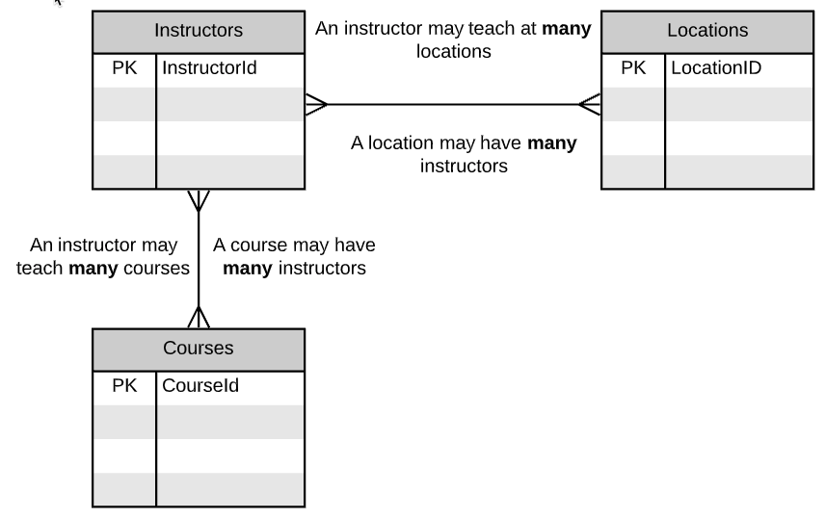
Identify Potential Entities and their relationships
Collect the data elements and group them together into entities that could make candidate tables. Is there a natural relationship between these entities? Is there a natural or surrogate key?

Slide 6
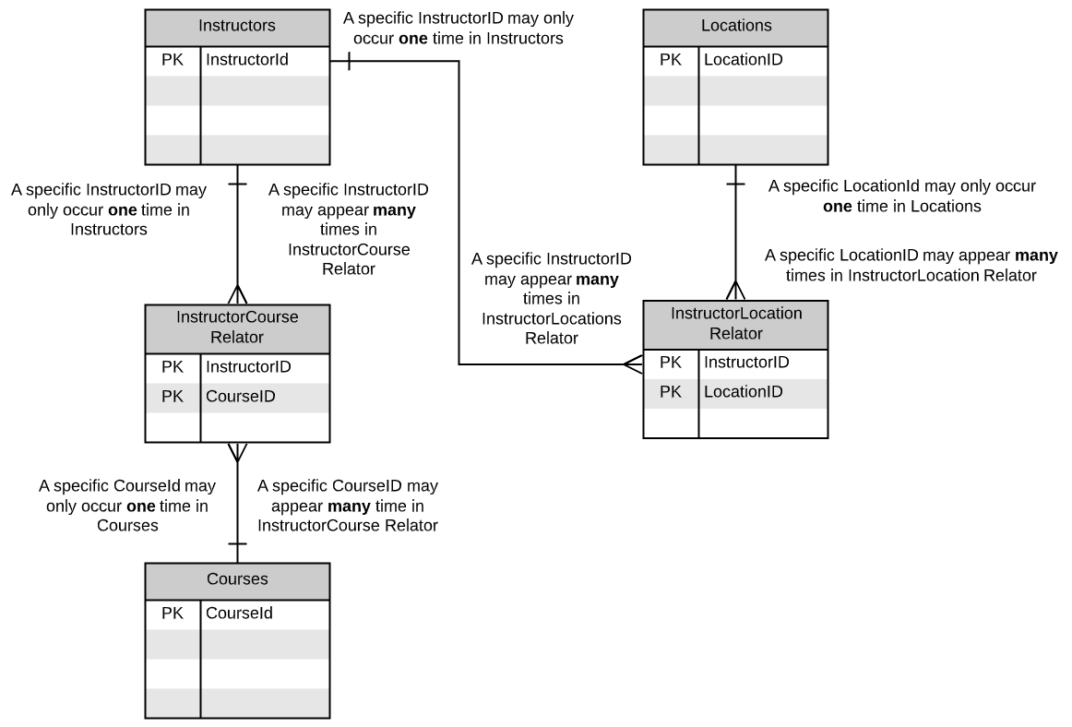
Use Join Tables to remove Many:Many Relationships
Entities that have a 1:1 relationship can be combined. Many:Many should have join tables.

Slide 7
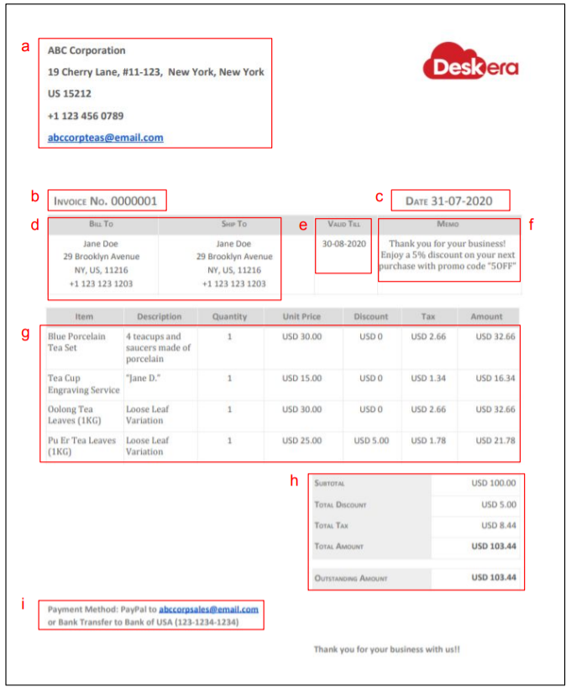

Slide 8
Database Normalization
Structured Data
Neatly arranged for easy analysis
Unstructured Data
no predefined organization making analysis difficult
Normalized
Unnormalized

Slide 9
Normalization
The process of improving a database design in steps, called forms of normalization.
Normalization has 4 goals:
arranging data into logical groupings such that each group describes a small part of the whole;
minimizing the amount of duplicate data stored in a database;
organizing the data such that, when you modify it, you make the change in only one place
building a database in which you can access and manipulate the data quickly and efficiently without compromising the integrity of the data in storage.

Slide 10

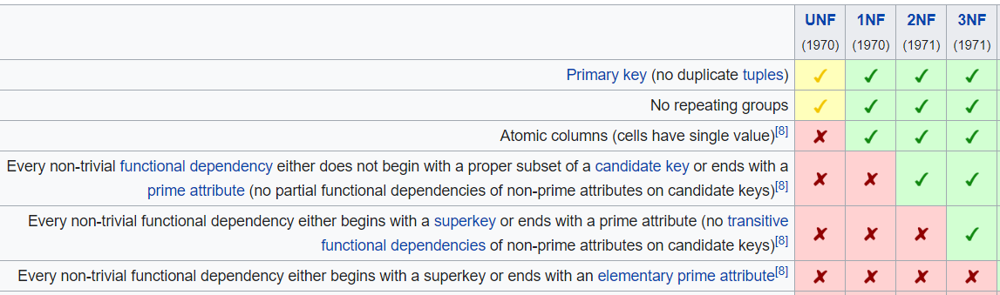
NORMAL FORMS
Database normalization is the process of structuring a database, usually a relational database, in accordance with a series of so-called normal forms in order to reduce data redundancy and improve data integrity. It was first proposed by Edgar F. Codd in 1970 as part of his relational model.

Slide 11


Slide 12
DDL - Data Definition Language
Data Definition Language (DDL) is a standard for commands that define the different structures in a database. DDL statements create, modify, and remove database objects such as tables, indexes, and users.
Common DDL statements are CREATE, ALTER, and DROP.

Slide 13
CREATE TABLE
CREATE TABLE city (
id serial,
name varchar(64) NOT NULL,
countrycode character(3) NOT NULL,
district varchar(64) NOT NULL,
population integer NOT NULL,
CONSTRAINT pk_city_id PRIMARY KEY (id),
CONSTRAINT fk_countrycode FOREIGN KEY (countrycode) REFERENCES country(code)
);

Slide 14
DROP TABLE
The DROP TABLE statement is used to remove a table definition and all associated data, indexes, rules, triggers, and constraints for that table.
DROP TABLE table_name;
DROP TABLE IF EXISTS table_name;

Slide 15
ALTER TABLE
ALTER TABLE command is used to add, delete or modify columns in an existing table.
You would also use ALTER TABLE command to add and drop various constraints on an existing table.
ALTER TABLE country
ADD FOREIGN KEY(capital)
REFERENCES city(id);
ALTER TABLE table_name ADD column_name datatype;
ALTER has LOTS OF OPTIONS, For a full reference visit: https://www.tutorialspoint.com/postgresql/postgresql_alter_command.htm

Slide 16


Table Constraints
A constraint is associated with a table and defines properties that the column data must comply with.
Types of Constraints
FOREIGN KEY - enforces valid PK values, and limits deletion of the PK row if FK row exists
DELETE FROM countries WHERE id=2;
DELETE FROM countries WHERE id=1;
ERROR: update or delete on table "countries" violates foreign key constraint "fk_countryid" on table "cities"
Detail: Key (id)=(1) is still referenced from table "cities".
City
id | country_id | name
1 | 6 | Milan
2 | 6 | Rome
3 | 7 | Beijing
4 | 4 | Nice
5 | 4 | Paris
6 | 1 | Toronto
7 | 5 | Seville
Country
id | name
1 | Canada
2 | Mexico
3 | Cuba
4 | France
5 | Spain
6 | Italy
7 | China

Slide 17
Table Constraints (cont.)
More Types of Constraints
NOT NULL - The column cannot contain a null value
UNIQUE - The column can only contain unique values
PRIMARY KEY - allows FKs to establish a relationship, and enforces NOT NULL and UNIQUE,
CHECK - specifies acceptable values that can be entered in the column
DEFAULT - provides a default value for the column
FOREIGN KEY

Slide 18
Database Sequences
A sequence is a special kind of database object designed for generating unique numeric identifiers. It is typically used to generate artificial primary keys. (actorID, storeID, customerID, etc)
In Postgres, serial is a special data type that encodes the following information:
Creates a new sequence object, and sets the default value for the column to be the next value produced by the sequence
since a sequence always produces non-NULL values, it adds a NOT NULL constraint to the column
If not using serial, you can create your own sequence and tell it what value to start at:
CREATE SEQUENCE ourid START 100;
The nextval function will return the next available number in the sequence called 'ourid'
SELECT nextval('ourid');

